Slide 1
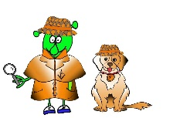
French Y3 Stage 1 Autumn 2:Months.
Language Detectives’ Memory Bank of “Months”
Noun Bank
janvier- January
février- February
mars- March
avril- April
mai- May
juin- June
juillet- July
août- August
septembre
octobre
novembre
décembre
Grammar
When words are the same in two languages we call them cognates and when they look very similar we call them semi-cognates.
Sound spelling
“é”
“em”
“ai
Fact Bank
Lots of the months in French look very similar to English spelling if the months.
Question and Answer Bank
Quand est ton anniversaire?- When is your birthday?

